Slide 1
PRELIMINARY PRESENTATION
AGV CONCEPT
A4.b

Slide 2
EEG1001 Model AGV Preliminary Presentation
Team Number:
A4.b
Team Name:
XXXXX
Team Member | Contribution
Amy Rowan Mansfield | Steering Design
Cormac Redhouse | Drive Design
Jackson Pettibone | AGV Design and Dimensioning
Alaistair Preece | AGV Assembly and Presentation
Presentation Date: xx-xx-xxxx

Slide 3
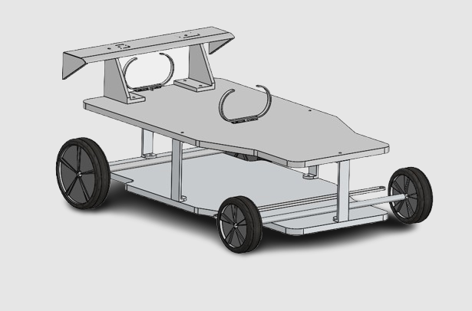
Chassis Design
BOM:
1x Spoiler
2x Spoiler Supports
2x Battery Supports
4x Supporting Brackets
2x Base Plates (255mm x 140mm footprint)
2x 57mm Wheels
2x 45mm Wheels

Slide 4
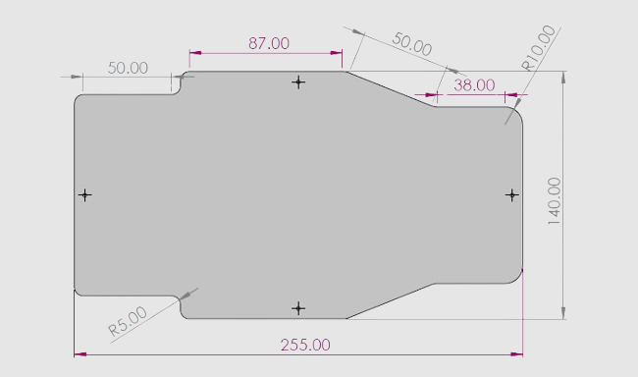
Chassis Design
Base Plate Dimensions

Slide 5
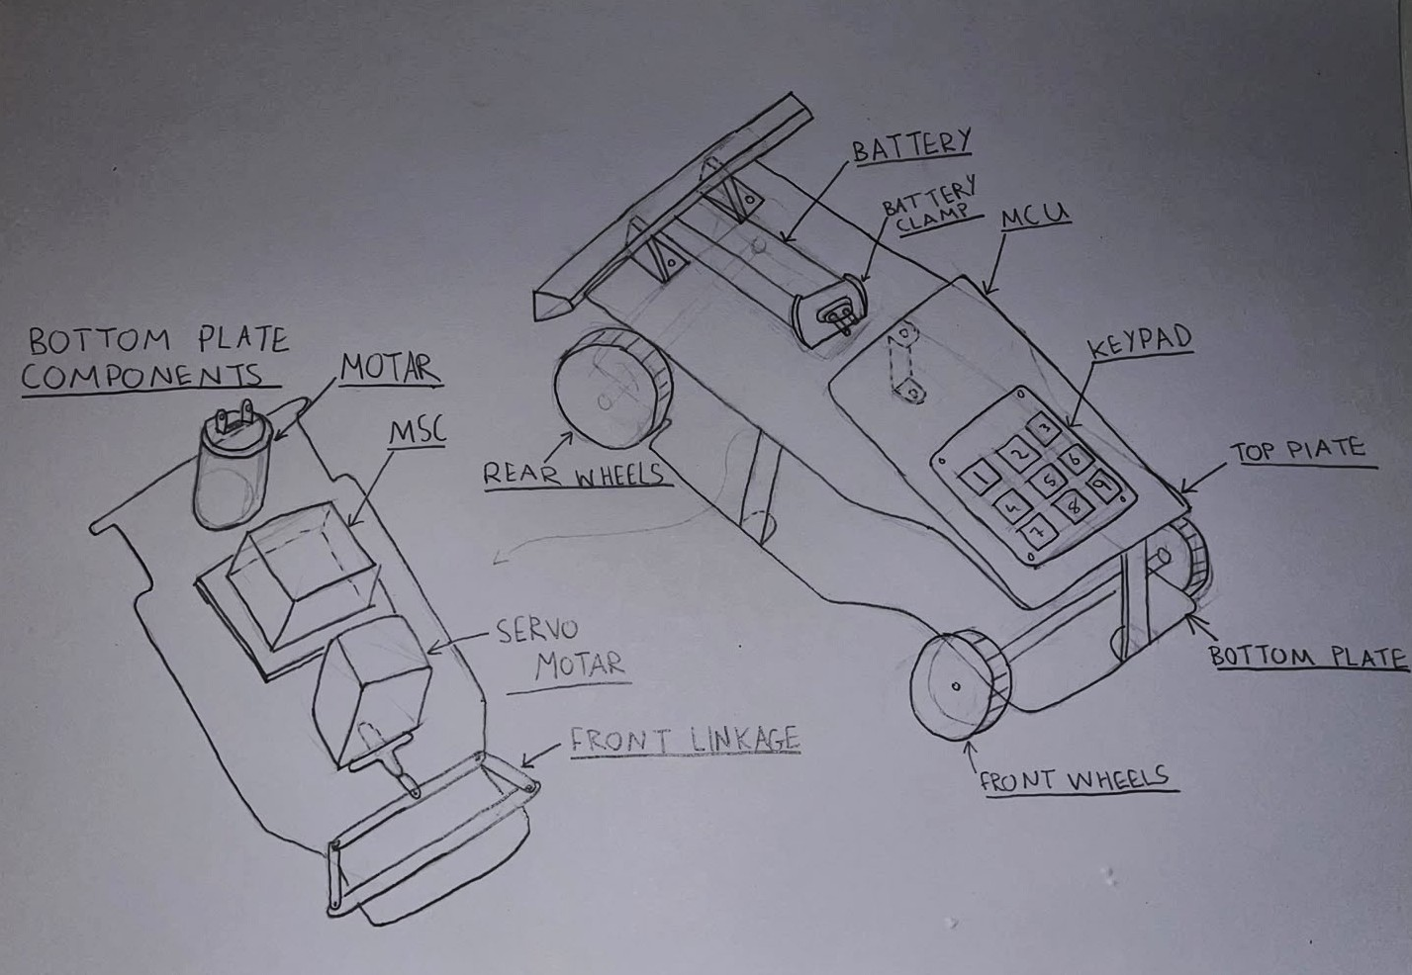
Component Layout Sketch

Slide 6
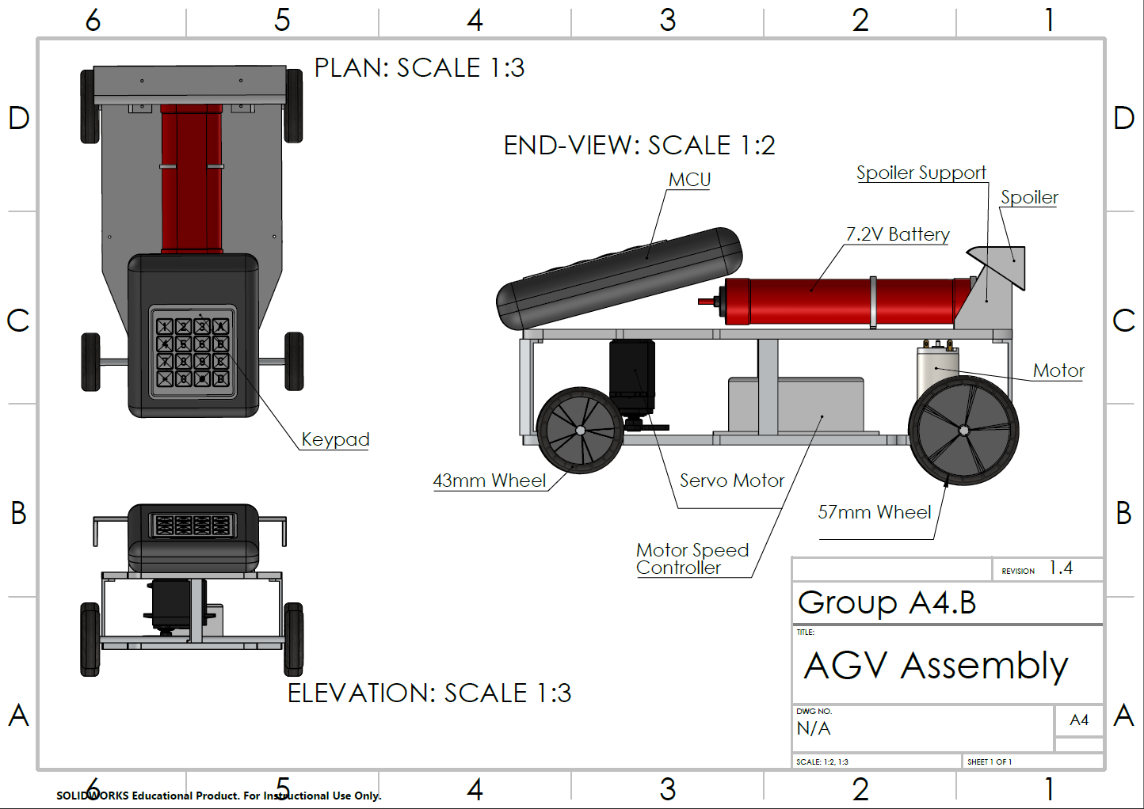

Slide 7
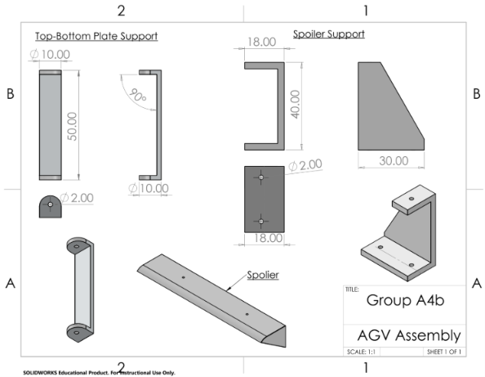

Slide 8
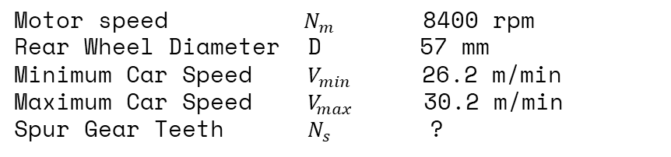
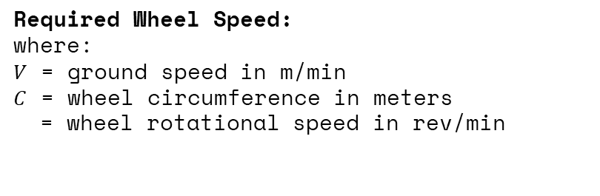








Drive Design
Symbol Value
Calculations:
1 wheel revolution

Slide 9
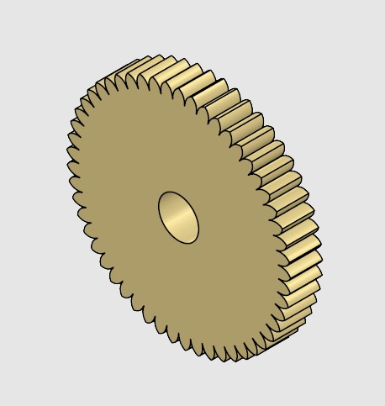






Drive Design
Number of Teeth:
50 – 57 Teeth Total

Slide 10
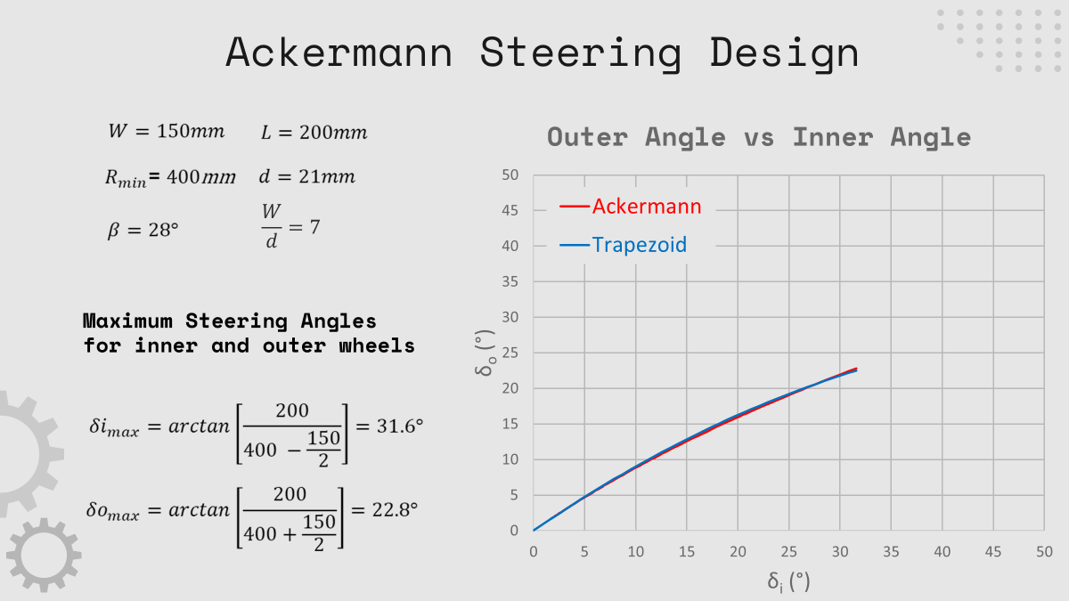

Slide 11
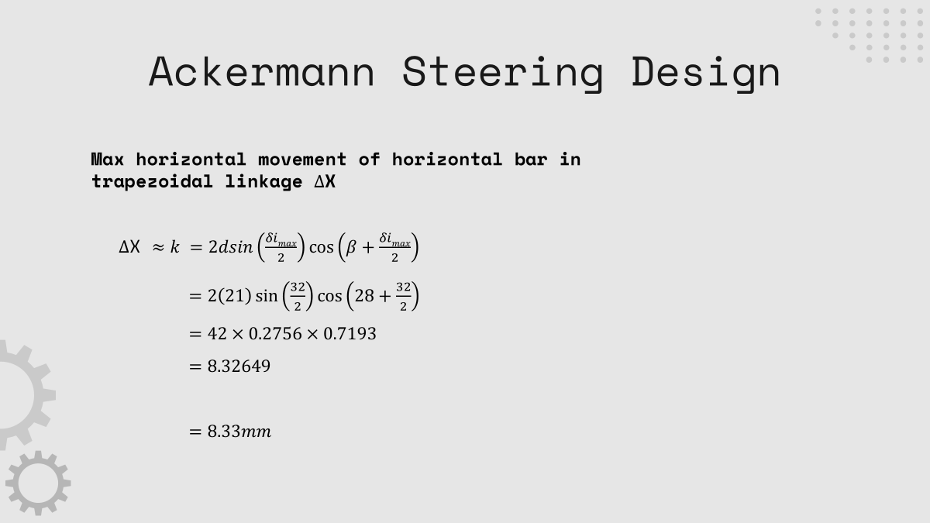

Slide 12
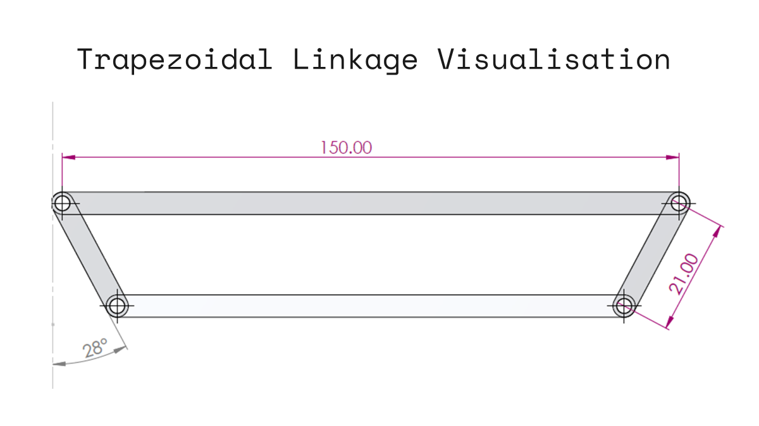

Slide 13
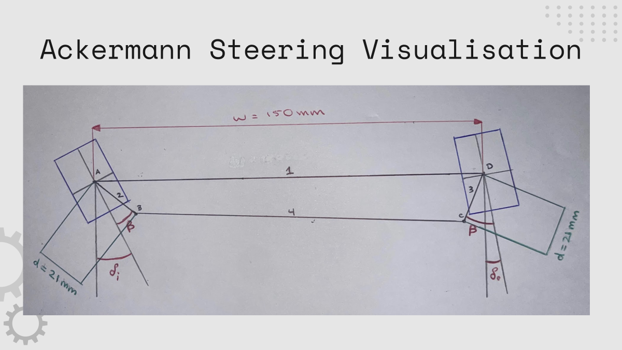

Slide 14
THANKS!

